Slide 1
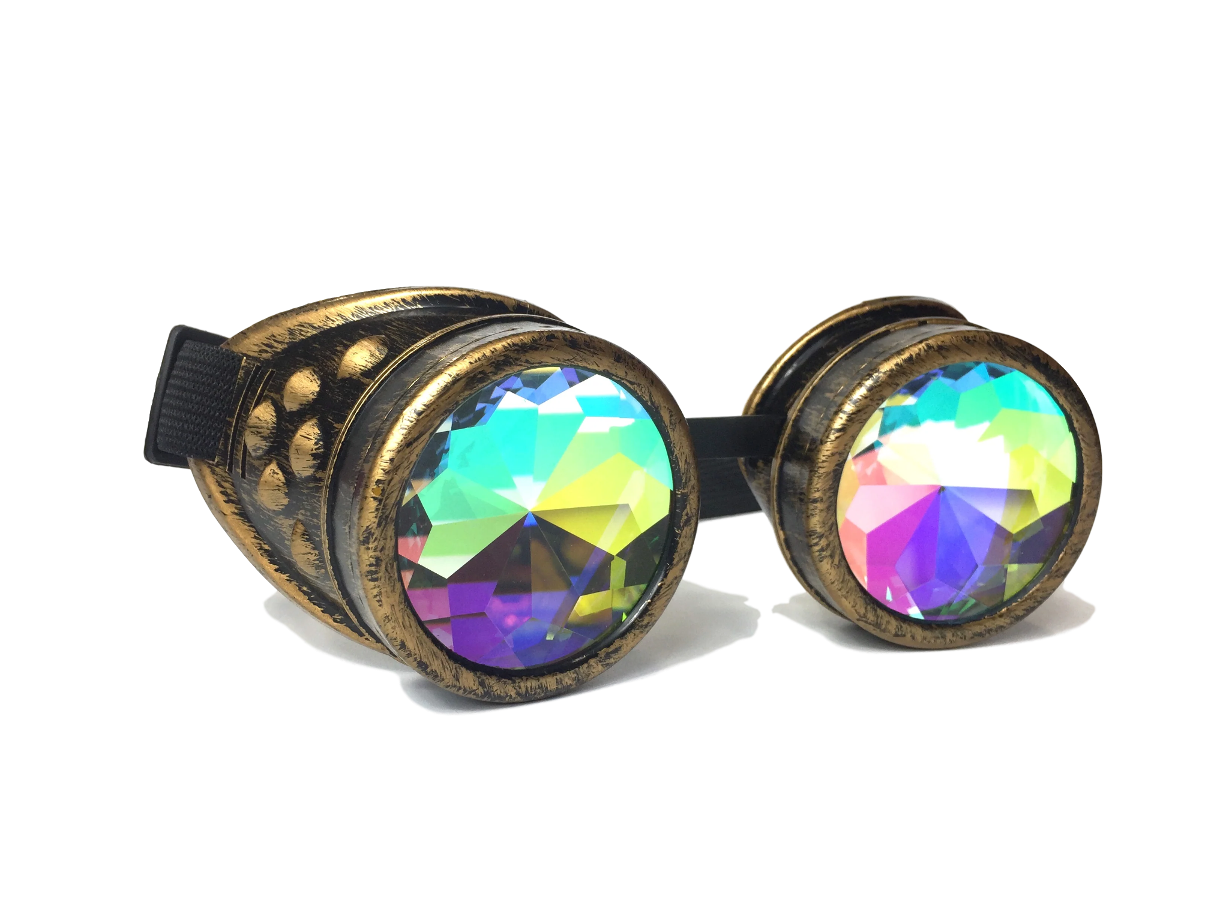
Mastering the Flux Mindset
Your Superpower for
Career Resilience
#AgileByExample 2024
Sylvia & Susanne Taylor

Slide 2
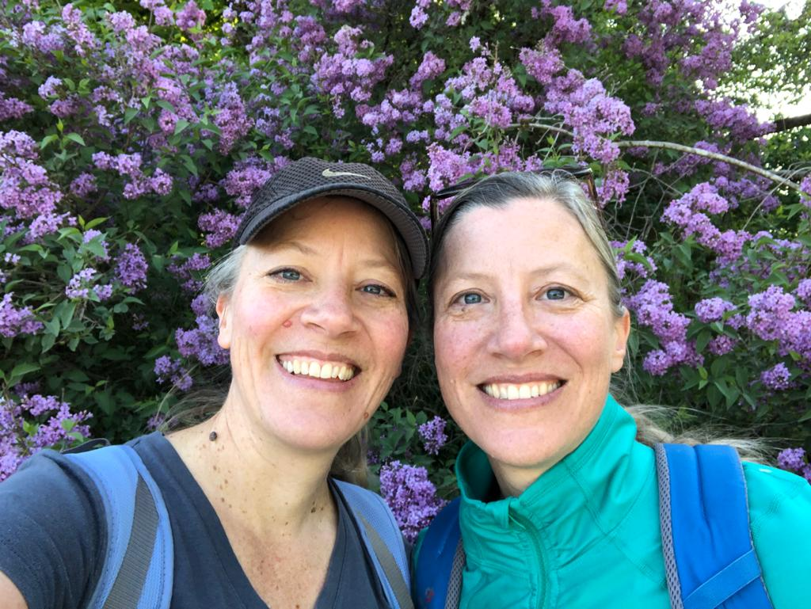
Who are we?
#(twin)sister
#coach
#facilitator
#foreigner
#womenintech
#changeagent
Notes:
Susanne:
Who are we? Who’s out there?

Slide 3
Notes:
Sylvia
Why are we the giving this talk?
We’ve had a lifetime of change that was both chosen and imposed on us. The last few years have tested even Our abilities to adapt and thrive.
The last few years has seen unprecedented change, it's been personal, cultural, annoying and also global.

Slide 4
…more & faster, change
Notes:
Susanne:
And we know, and are SURE others feel this too… the rate of change is not slowing down - it’s only getting FASTER.

Slide 5
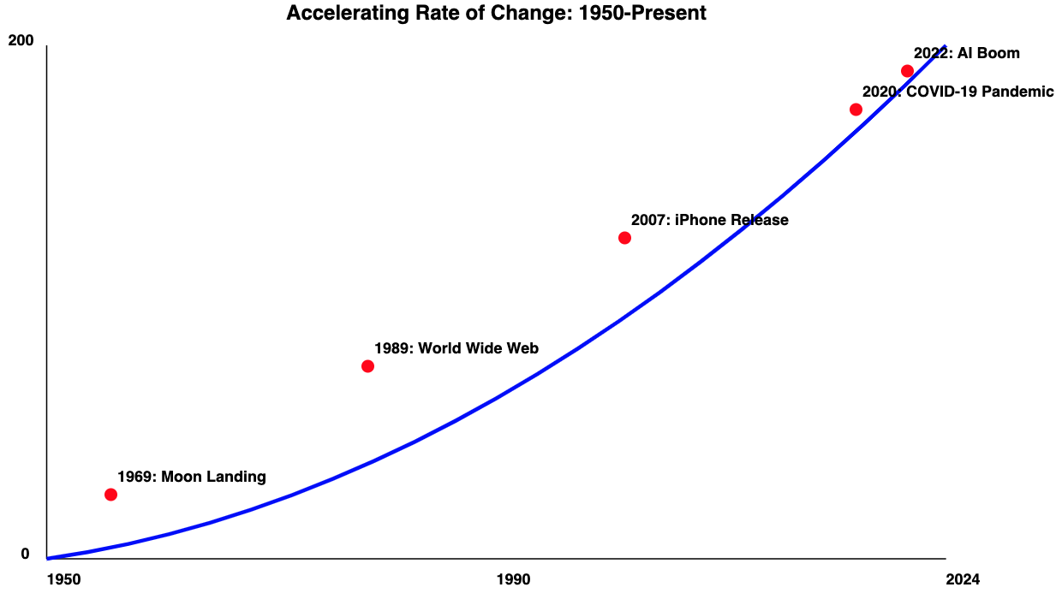
Notes:
Sylvia:
Since 1980 the rate of change has only increased.
We used to have time to process the change and get a pause to integrate things and live with it, now it’s rapid and constant.
Accelerated rate of change has all of us sometimes wondering… what’s next?!

Slide 6
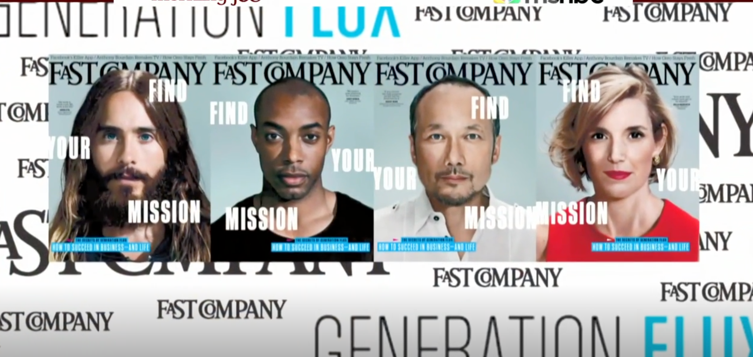
Welcome to
Generation Flux
Fast Company Magazine 2014
Notes:
Susanne
Even as far back as 2014, the magazine Fast Company coined the term - Generation Flux - to describe those folks of all ages who have the mindset to embrace the change that is in front of them.
https://www.msnbc.com/morning-joe/watch/what-is-generation-flux--359076931602
In the midst of all of our change

Slide 7
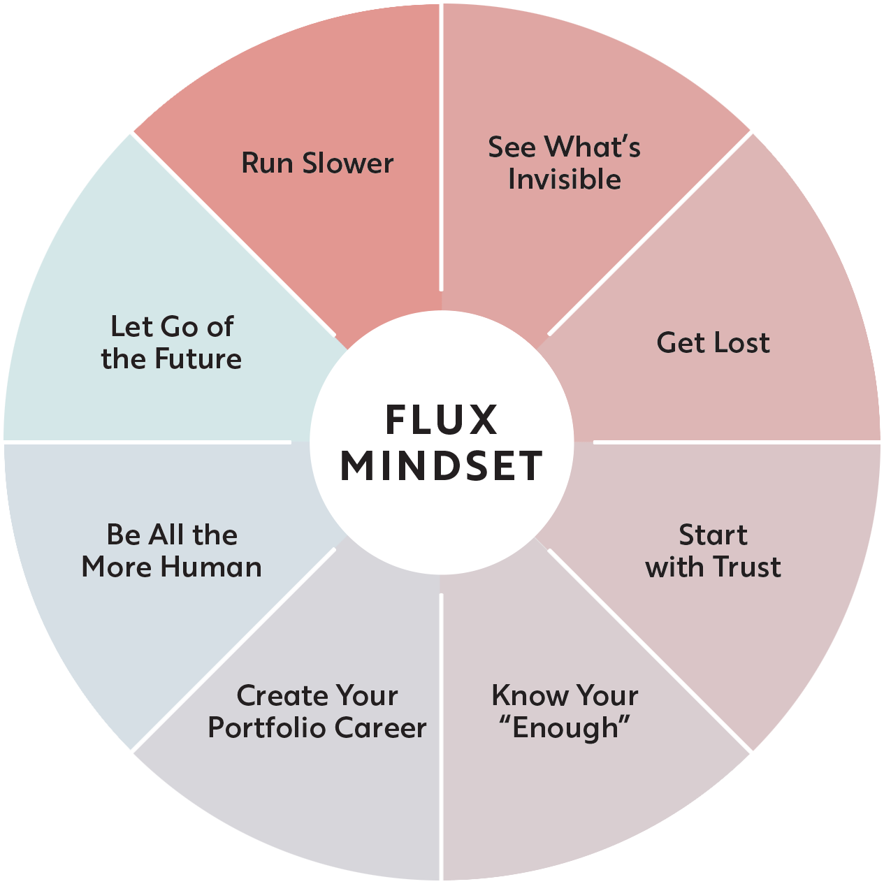
Flux:
(n.) Continuous change
(v.) to cause or learn to become fluid
Flux Framework - created by April Rinne 2020
Notes:
Sylvia
2022 we discovered that all our knowledge has been codified into a clear set of capacities or Superpowers and now has a name - FLUX!
In 2020 April Rinne wrote a book to share this framework that shared a mindset that can help us adapt - Flux.
Both noun and verb.
Flux Mindset is the ability to perceive all change not as a good or bad, but as an opportunity.

Slide 8
All change starts with the individual, and internally.
Change can equal opportunity, not just chaos.
Notes:
Susanne:
→ All change starts internally, and is individual.
→ Change can = opportunity, not just chaos.

Slide 9
See change in new ways, reshape our relationship to change…
Notes:
Susanne:
Change is like the weather - we can enjoy it when we accept it.
Like the weather, so much of our change happens without us knowing it’s coming - or being able to control it.
Sylvia:
We created tools to help us deal with change in the weather - gps, umbrellas, sunglasses.
So today, our goal is to help you see change in new ways, maybe develop new responses to change, and ultimately reshape your relationship to change.

Slide 10
Old script vs New Script
Notes:
Susanne: What’s a script
Our ‘scripts’ are the way we believe we should behave. It is our cultural programming.
It shapes our beliefs and assumptions about the world and people around us.
The script from our parents and the society we grew up in has informed our personal scripts.

Slide 11
REWRITE IT
Notes:
Sylvia:
The OLD script is keeping us stuck… and we need to develop some new capabilities to be able to create a NEW script and create a FLUX mindset,
If we can rewrite them, so that they serve us now, in this new world we’ve created with technology and massive climate change, We will THRIVE, not just survive, in this modern world of rapid constant change.
So… let’s flip your script - Shifting your OLD SCRIPT into a NEW SCRIPT - and practicing your Superpowers to build it and develop a “Flux mindset…”

Slide 12
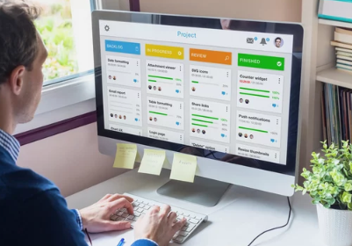
Apply Agile practices to personal development
Notes:
Susanne
We’re all here because we believe in agility—the ability to respond to change, to adapt quickly, and to continuously improve.
We apply them to our teams and how we develop our products… why not apply these principles to our own careers?

Slide 13
To thrive in a fast-paced world,
Create Your Portfolio Career.
Notes:
Sylvia:
We will explore one of the 8 Superpowers with you here at Agile By Example - Create a Portfolio Career,
A portfolio career helps you iterate, adapt, and grow in the same way Agile helps teams.
We believe it can help you establish you career resilience and rethink how you navigate your work choices from today and beyond.
Susanne shares personal example of career shift (intercultural relations -> change management -> agile coach role)
Sylvia:
In Agile, we know versatility & diversity leads to innovation. The same is true for your career—a portfolio approach allows you to cross boundaries, take on new roles, and intentionally respond to change.”

Slide 14
Notes:
Susanne:
A portfolio career is about diversifying your skills, experiences, and opportunities. Instead of being defined by a single role or career path, you can embrace multiple projects, passions, and learning opportunities.”
Sylvia:
For example, I started my tech career 22 years ago at Microsoft Producer, Marketing, then after Masters to HR, then Agile Consulting as I brought change management, team dynamics, communication and strong facilitation… I was constantly learning new skills as I saw what doors were opening - not in HR, but back to tech, and most recently, supporting People teams again with organizational adaptability.
Susanne:
The world is constantly changing—new technologies, methodologies, market demands. Having a linear career path worked in a more predictable world, but not in this one.
When we strengthen our Flux mindset it equips us for these challenges, because we will be more prepared to gain more diverse skills, and experiences, to be able to shift and pivot in our unpredictable world, being able to better build a portfolio career.

Slide 15
Notes:
Susanne:
We’re no strangers to the concept of ‘inspect and adapt.’ A portfolio career is about inspecting where your skills can add value in new contexts and adapting quickly to seize opportunities that align with our values and strengths.”
Agile teaches us that change is not just expected—it’s embraced. In your career, this might mean shifting industries, exploring side projects, or learning new skills.”
Sylvia:
Provide an example of a leader in tech who successfully pivoted into a new role or field, thanks to their versatile portfolio.Markus Z - HR to Agile - tech to NGo
In your career, when you can identify skills that are no longer serving you and doubling down on the ones that provide the most value, you have more opportunities to pivot to new roles and industries.”
Susanne:
“What’s one skill you have today that you think could create unexpected value in a different context?”

Slide 16
Notes:
Sylvia:
Can you think of a time when you shifted your career path, whether it was a new role, project, or skill? What did that change unlock for you?”
Susanne:
Ok, So, go ahead and find a partner and share with them in one sentence what was unlocked when you shifted. (2-3 minutes).

Slide 17
To Build a Resilient Portfolio Career:
Consider
Cross-pollinate
Curate
Notes:
Susanne: transition
So how do you go about building a resilient career path? We will start now!
These are three powerful ways to do that.

Slide 18
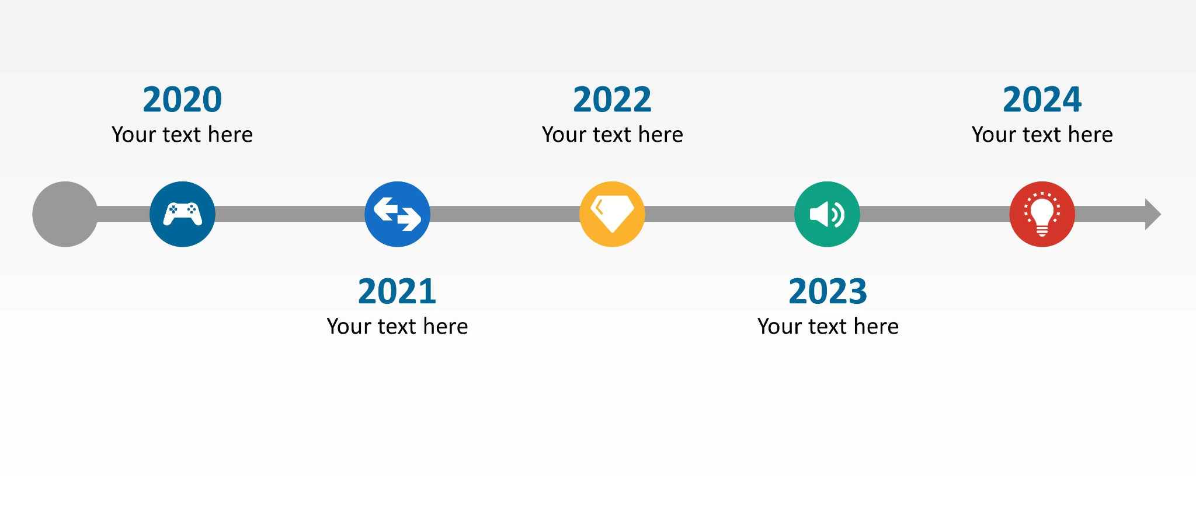
1
Consider:
What’s already in your portfolio?
Notes:
Susanne:
Identify and Leverage Your Core Skills: “Identify your ‘X-shaped’ skills—what you’re deeply specialized in and what you’re broadening. Make sure to leverage those in diverse areas.”
Consider your own timeline, ALL your jobs, hobbies, places you have volunteered, or helped out.
All the skills you picked up, not just from a formal workplace, but all those places and times you were learning.
All the things you liked. All the things you didn’t!

Slide 19
2
Cross-Pollinate:
Bring knowledge & experience into a new domain
Notes:
Sylvia:
You don’t need to stay in your own lane as a cross-pollinator - you take the useful skill or expertise and bridge that into opportunities elsewhere.
Just like when we are being Agile, we focus on iterations, experiments.
You can cross-pollinate in your own career (my example). Producer, Project Manager, Customer Marketing, Photographer, Facilitator, Coach, Agile Consultant, Adaptability consultant.
When you open your Flux mindset and start to write your new script you will start to see that your career is an evolution, each move an expansion, improvement, and adventure that aligns with your own evolution of self.

Slide 20
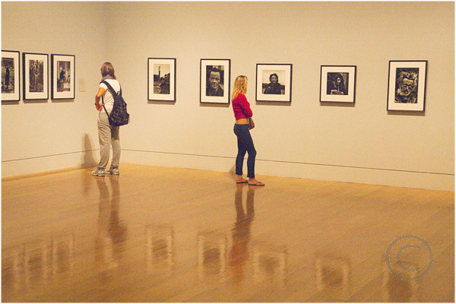
3
Curate:
Be ready to unlearn and relearn
Notes:
Susanne
Once your portfolio is established, you can shift to curation mode. This is your ongoing, evergreen career.
In our world of Flux, the future of work, the portfolio career gives you unparalleled combination of flexibility, stability, longevity and meaning.
You can Upgrade, rebalance, update, expande, reorganize - your script and mindset

Slide 21
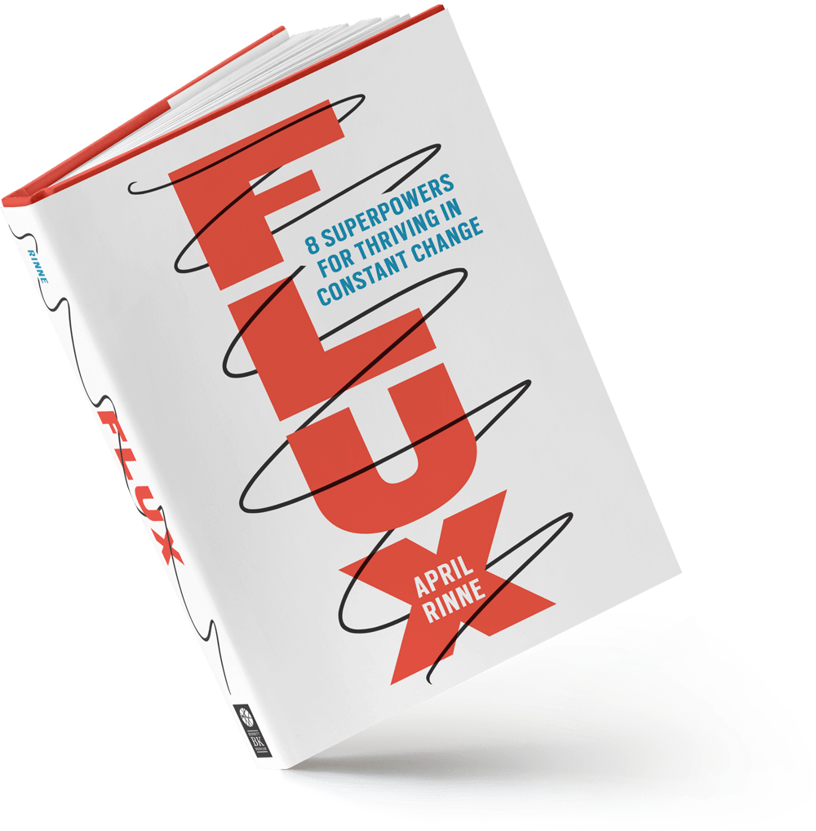
More FLUX Resources
1. Flux - by April Rinne
2. FluxMindset.com
3. TED Talk: How to navigate our uncertain future.
4. Join our online Flux@Work community - Coming in 2025
5. Discover - How adaptable are you (AQ=Adaptability Quotient)? (ask Sylvia)
Practice = an intentional action you choose to take over and over.
Notes:
Sylvia:
Absolutely everything you do affects how you navigate change - and we get better as we practice.
It begins with the belief that we CAN change our relationship with change (from fear to excitement or at least curiosity)
But it takes practice… all the ways to practice…
Now you have more tools to build a resilient Portfolio Career, so you can truly embrace the future.

Slide 22
Image Credit: istock - N8tureGirl
Notes:
Sylvia: N8tureGrl
The world of work is becoming more decentralized, and the skills that served you five years ago may not serve you in the next five. A portfolio career ensures that you are adaptable, resilient, and ready for whatever comes next.”
You’ve already mastered the Agile mindset—now it’s time to apply it to your career. Embrace change, diversify your skills, and create a career that thrives in flux.”
What’s one small step you can take today to start building your portfolio career? We challenge you to identify one area where you can experiment, learn, or grow.”

Slide 23
Thank you!
Dziękuję!
Notes:
Both Speakers!

Slide 24
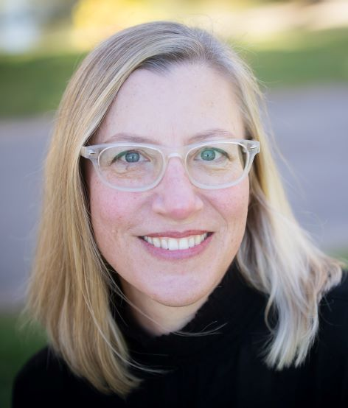
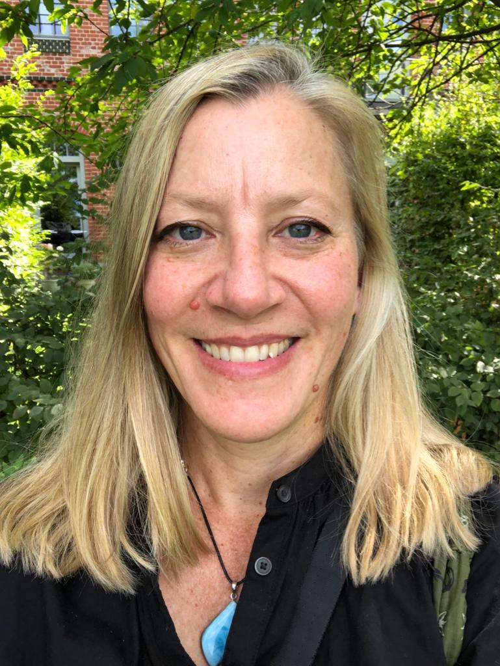
“Mastering change begins with mastering ourselves.”
Susanne Taylor
New Work & Team Alchemist
taylor.susanne@gmail.com
LinkedIn: https//www.linkedin.com/in/susanne-taylor-intuitive
Sylvia Taylor
Change & Adaptability Consultant
sylvia@intentionalwork.eu
LinkedIn: https://www.linkedin.com/in/sylviataylor/

